Slide 1
HARDWARE DESCRIPTION LANGUAGE (HDL):
Manual methods for designing logic circuits are feasible only when the circuit is small.
For anything else (i.e., a practical circuit), designers use computer-based design tools.
Prototype integrated circuits are too expensive and time consuming to build, so all modern design tools rely on a hardware description language to describe, design, and test a circuit in software before it is ever manufactured.

Slide 2
A hardware description language (HDL) is a computer-based language that describes the hardware of digital systems in a textual form.
It resembles an ordinary computer programming language, such as C, but is specifically oriented to describing hardware structures and the behavior of logic circuits.
It can be used to represent logic diagrams, truth tables, Boolean expressions, and complex abstractions of the behavior of a digital system.

Slide 3
The term FPGA stands for Field Programmable Gate Array and, it is a type of semiconductor logic chip which can be programmed to become almost any kind of system or digital circuit, similar to PLDs.
PLDS are limited to hundreds of gates, but FPGAs supports thousands of gates.
The configuration of the FPGA architecture is generally specified using a language, i.e., HDL (Hardware Description language) which is similar to the one used for an ASIC ( Application Specific Integrated Circuit).

Slide 4
HDLs are used in several major steps in the design flow of an integrated circuit (IC):
Design entry,
Functional simulation or verification,
Logic synthesis,
Timing verification,
and fault simulation.
Design entry: It creates an HDL-based description of the functionality that is to be implemented in hardware. Depending on the HDL, the description can be in a variety of forms: Boolean logic equations, truth tables, a netlist of interconnected gates, or an abstract behavioral model.

Slide 5
Logic simulation: It displays the behavior of a digital system through the use of a computer.
A simulator interprets the HDL description and either produces readable output, such as a time-ordered sequence of input and output signal values, or displays waveforms of the signals.
The simulation of a circuit predicts how the hardware will behave before it is actually fabricated.
Simulation detects functional errors in a design without having to physically create and operate the circuit.
The stimulus (i.e., the logic values of the inputs to a circuit) that tests the functionality of the design is called a test bench.

Slide 6
Thus, to simulate a digital system, the design is first described in an HDL and then verified by simulating the design and checking it with a test bench, which is also written in the HDL.
Logic synthesis: It is the process of deriving a list of physical components and their interconnections (called a netlist ) from the model of a digital system described in an HDL.
The netlist can be used to fabricate an integrated circuit or to lay out a printed circuit board (PCB) with the hardware counterparts of the gates in the list.
The design of today’s large, complex circuits is made possible by logic synthesis software.

Slide 7
Timing verification: It confirms that the fabricated, integrated circuit will operate at a specified speed.
Timing verification checks each signal path to verify that it is not compromised by propagation delay.
This step is done after logic synthesis specifies the actual devices that will compose a circuit and before the circuit is released for production.

Slide 8
History of HDL:
Companies that design integrated circuits use proprietary and public HDLs.
In the public domain, there are two standard HDLs that are supported by the IEEE: VHDL and Verilog.
VHDL is a Department of Defense–mandated language. (The V in VHDL stands for the first letter in VHSIC, an acronym for very high-speed integrated circuit.)
Verilog began as a proprietary HDL of Cadence Design Systems.
VHDL is more difficult to learn than Verilog. Because Verilog is an easier language than VHDL to describe, learn, and use.

Slide 9
Module Declaration:
A Verilog model is composed of text using keywords, which are predefined lowercase identifiers that define the language constructs. Examples of keywords are module, endmodule, input, output, wire, and, or, and not.
Verilog is case sensitive (e.g., not is not the same as NOT).
The term module refers to the text enclosed by the keyword pair module . . . endmodule.
A module is the fundamental descriptive unit in the Verilog language.

Slide 10
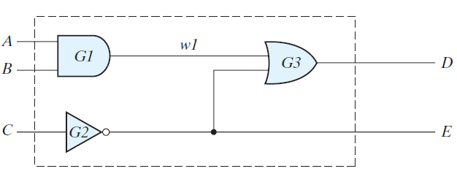
It is declared by the keyword module and must always be terminated by the keyword endmodule.
The HDL description of the following circuit is shown in the following HDL Example .

Slide 11
HDL Example (Combinational Logic Modeled with Primitives)
// Verilog model of circuit. IEEE 1364–1995 Syntax
module Simple_Circuit (A, B, C, D, E);
output D, E;
input A, B, C;
wire w1;
and G1 (w1, A, B); // Optional gate instance name
not G2 (E, C);
or G3 (D, w1, E);
endmodule

Slide 12
The first line of text is a comment (optional). The second line begins with the keyword module and starts the declaration (description) of the module; the last line completes the declaration with the keyword endmodule.
The keyword module is followed by a name and a list of ports. The name ( Simple_Circuit in this example) is an identifier. Identifiers are names given to modules, variables (e.g., a signal), and other elements of the language.
Identifiers are composed of alphanumeric characters and the underscore (_), and are case sensitive. Identifiers must start with an alphabetic character or an underscore, but they cannot start with a number.

Slide 13
The ports are the inputs and outputs of the circuit. The port list is enclosed in parentheses, and commas are used to separate elements of the list.
The statement is terminated with a semicolon (;). the keywords input and output specify which of the ports are inputs and which are outputs.
Internal connections are declared as wires. The circuit in this example has one internal connection, at terminal w1 , and is declared with the keyword wire.

Slide 14
The structure of the circuit is specified by a list of (predefined) primitive gates, each identified by a descriptive keyword ( and, not, or ).
The elements of the list are referred to as instantiations of a gate, each of which is referred to as a gate instance .
Each gate instantiation consists of an optional name (such as G1, G2 , etc.) followed by the gate output and inputs separated by commas and enclosed within parentheses.
The output of a primitive gate is always listed first, followed by the inputs.

Slide 15
For example, the OR gate of the schematic is represented by the or primitive, is named G3 , and has output D and inputs w1 and E . ( Note : The output of a primitive must be listed first, but the inputs and outputs of a module may be listed in any order.)
The module description ends with the keyword endmodule.
Each statement must be terminated with a semicolon, but there is no semicolon after endmodule.

Slide 16
Gate Delays:
All physical circuits exhibit a propagation delay between the transition of an input and a resulting transition of an output.
When an HDL model of a circuit is simulated, it is sometimes necessary to specify the amount of delay from the input to the output of its gates.
In Verilog, the propagation delay of a gate is specified in terms of time units and by the symbol #.
The numbers associated with time delays in Verilog are dimensionless.
The association of a time unit with physical time is made with the ‘timescale compiler directive.

Slide 17
Such a directive is specified before the declaration of a module and applies to all numerical values of time in the code that follows.
An example of a timescale directive is ‘timescale 1ns/100ps.
The first number specifies the unit of measurement for time delays.
The second number specifies the precision for which the delays are rounded off, in this case to 0.1 ns.
If no timescale is specified, a simulator may display dimensionless values or default to a certain time unit, usually 1ns.

Slide 18
In the description of the simple circuit of above Example , propagation delays specified for each gate are as and, or , and not gates have a time delay of 30, 20, and 10 ns, respectively.
If the circuit is simulated and the inputs change from A , B , C = 0 to A , B , C = 1, the outputs change as shown in Table.
The output of the inverter at E changes from 1 to 0 after a 10-ns delay. The output of the AND gate at w1 changes from 0 to 1 after a 30-ns delay. The output of the OR gate at D changes from 1 to 0 at t = 30 ns and then changes back to 1 at t = 50 ns. In both cases, the change in the output of the OR gate results from a change in its inputs 20 ns earlier.

Slide 19
HDL Example (Gate-Level Model with Propagation Delays)
// Verilog model of simple circuit with propagation delay
module Simple_Circuit_prop_delay (A, B, C, D, E);
output D, E;
input A, B, C;
wire w1;
and #(30) G1 (w1, A, B);
not #(10) G2 (E, C);
or #(20) G3 (D, w1, E);
endmodule

Slide 20
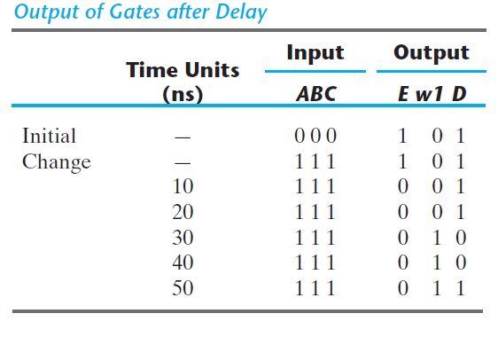

Slide 21
Writing a test bench:
An HDL description that provides the stimulus to a design is called a test bench.
Note that the test bench (t_Simple_Circuit_prop_delay ) has no input or output ports. Within the test bench, the inputs to the circuit are declared with keyword reg and the outputs are declared with the keyword wire.
The initial keyword is used with a set of statements that begin executing when the simulation is initialized; the signal activity associated with initial terminates execution when the last statement has finished executing.

Slide 22
The initial statements are commonly used to describe waveforms in a test bench. The set of statements to be executed is called a block statement
and consists of several statements enclosed by the keywords begin and end.
The statements are executed in sequence, left to right, from top to bottom, by a simulator in order to provide the input to the circuit. Initially, A, B, C = 0. ( A, B, and C are each set to 1’b0, which signifies one binary digit with a value of 0.) After 100 ns, the inputs change to A, B, C = 1.
After another 100 ns, the simulation terminates at time 200 ns.

Slide 23
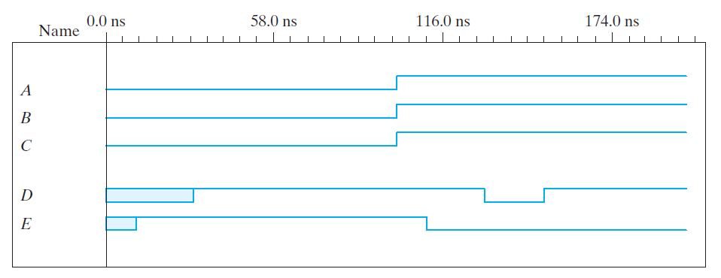
A second initial statement uses the $finish system task to specify termination of the simulation. If a statement is preceded by a delay value (e.g., #100), the simulator postpones executing the statement until the specified time delay has elapsed.
The timing diagram of waveforms that result from the simulation is shown in the following figure.

Slide 24
// Test bench for Simple_Circuit_prop_delay
module t_Simple_Circuit_prop_delay;
wire D, E;
reg A, B, C;
Simple_Circuit_prop_delay M1 (A, B, C, D, E);
// Instance name required
initial
begin
A = 1'b0; B = 1'b0; C = 1'b0;
#100 A = 1'b1; B = 1'b1; C = 1'b1;
end
initial #200 $finish;
endmodule

Slide 25
Boolean Expressions:
Boolean equations describing combinational logic are specified in Verilog with a continuous assignment statement consisting of the keyword assign followed by a Boolean expression.
To distinguish arithmetic operators from logical operators, Verilog uses the symbols (&), (/), and (~) for AND, OR, and NOT (complement), respectively.
Thus to describe the simple circuit of above Fig. with a Boolean expression, we use the statement
assign D = (A && B) || (!C);

Slide 26
The following HDL Example describes a circuit that is specified with the following two Boolean expressions:
E = A + BC + B’D
F = B’C + BC’D’
The equations specify how the logic values E and F are determined by the values of A, B, C, and D .
// Verilog model: Circuit with Boolean expressions
module Circuit_Boolean_CA (E, F, A, B, C, D);
output E, F;
input A, B, C, D;
assign E = A || (B && C) || ((!B) && D);
assign F = ((!B) && C) || (B && (!C) && (!D));
endmodule

Slide 27
The simulator detects when the test bench changes a value of one or more of the inputs.
When this happens, the simulator updates the values of E and F .
The continuous assignment mechanism is so named because the relationship between the assigned value and the variables is permanent.
The mechanism acts just like combinational logic, has a gate-level equivalent circuit, and is referred to as implicit combinational logic .

Slide 28
User-Defined Primitives:
The logic gates used in Verilog descriptions with keywords and, or, etc., are defined by the system and are referred to as system primitives.
The user can create additional primitives by defining them in tabular form. These types of circuits are referred to as user-defined primitives (UDPs).
One way of specifying a digital circuit in tabular form is by means of a truth table.
UDP descriptions do not use the keyword pair module . . . endmodule. Instead, they are declared with the keyword pair primitive . . . endprimitive.

Slide 29
Following HDL Example defines a UDP with a truth table. It proceeds according to the following general rules:
• It is declared with the keyword primitive , followed by a name and port list.
• There can be only one output, and it must be listed first in the port list and declared with keyword output
• There can be any number of inputs. The order in which they are listed in the input declaration must conform to the order in which they are given values in the table that follows.
• The truth table is enclosed within the keywords table and endtable.

Slide 30
• The values of the inputs are listed in order, ending with a colon (:). The output is always the last entry in a row and is followed by a semicolon (;).
• The declaration of a UDP ends with the keyword endprimitive.

Slide 31
// Verilog model: User-defined Primitive
primitive UDP_02467 (D, A, B, C);
output D;
input A, B, C;
//Truth table for D 5 f (A, B, C) 5 Σ(0, 2, 4, 6, 7);
table
// A B C : D // Column header comment
0 0 0 : 1;
0 0 1 : 0;
0 1 0 : 1;
0 1 1 : 0;
1 0 0 : 1;
1 0 1 : 0;
1 1 0 : 1;
1 1 1 : 1;
endtable
endprimitive

Slide 32
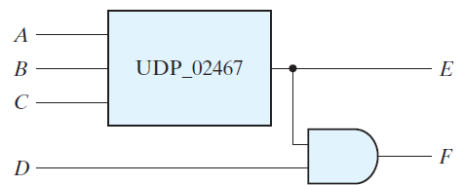
// Verilog model: Circuit instantiation of Circuit_UDP_02467
module Circuit_with_UDP_02467 (e, f, a, b, c, d);
output e, f;
input a, b, c, d
UDP_02467 (e, a, b, c);
and (f, e, d); // Option gate instance name omitted
endmodule
The declaration Circuit _with _UDP_ 02467 (E, F, A, B, C, D);
will produce a circuit that implements the hardware shown below:

Slide 33
